Slide 1
Reorganizing Health Care Delivery Through a Value Based Approach

Slide 2
Overview of the Case
Cost increased
Value gain less than expected
A pilot program projected: VALUE-BASED CARE
Issues
Patients with symptoms but remained undiagnosed (diabetes case, England)
Traditional payment methods:
block payment
Capitation
Pay-for-performance
Payment by results (PbR/case base)
fee-for-service
Notes:
Overview of the Case:
We are witnessing the big change in healthcare systems over the world where traditional care processes no longer meet the patient’s demands and payment methods to care providers no longer fit. We need a new approach in which can balance the cost cuts but also provide adequate quality care to patients. In the case study, traditional methods mentioned are block payment, capitation, pay-for-performance, payment by results (PbR/case base), and fee-for-service. However, the medical costs recently kept going up in England healthcare where the nation was spending too much but the value was not gained as much as expected. Especially, the most chronic issue was consuming a high portion of healthcare expenditure and having high consequences to the nation’s economy was “diabetes”. As measured, the country spent 1 million Euro to treat diabetes patients, but it was expressed that the current system did not produce good outcomes as expected. A new approach named value-based commission (VBC) program was introduced by North Central London (NCL) in England, focusing on medical care for diabetes population as a pilot program.

Slide 3
Overview of the Case
“Value” term: how much money is spent on a service compared to how many outcomes are achieved
Value-based care = outcomes-based care:
reimburse providers efficiently + improve the value of services
Core: focus on early intervention, prevention, and recovery (early stage is always better than later)
Outcome = criterion: patients are center and treated holistically.
Led by Camden Clinical Commissioning Group (CCG): planned in 3 phases
Notes:
A definition of “value” term was defined as how much money spent on a service and how much we achieved its outcome. Deeper, value-based care (or called interchangeably outcomes-based care) was depicted as a way not only to organize, measure, and reimburse the healthcare providers efficiently but also to improve the value of services, according to the article. The core of value-based care is value-driven by focusing on early intervention, prevention, and recovery where early results is a promise which helps to save costs but gain more effectiveness. The pilot program was led by Camden Clinical Commissioning Group (CCG) with a group of diagnosed or undiagnosed diabetes patients and some other experts who helped to design and improve the value-based care target. The program took value or outcomes as a criterion where outcomes defined patients are center and treated holistically – the procedure to take care a patient entire circle from health to quality of life. The program was planned in three phases. Two first phases were done while the third phase was pending on the result.

Slide 4
Description of Scale
1/17 individuals: diagnosed or undiagnosed with diabetes symptoms
Estimately 30% increase (by 2025)
£10 billion (10% of the total national budget) for diabetes care annually
£33.8 billion additional increased (because of Covid-19)
Notes:
II. In the UK, more than one person with diabetes symptoms—diagnosed or undiagnosed—was present for every seventeen individuals. The case discusses the issue of rising medical costs yet undetected diabetes in the population of England. Approximately £10 billion (or 10% of the total national budget) was spent on diabetes care each year. By 2025, it was anticipated that 5 million people in the UK would be affected, a 30% rise in the number of sufferers since 2006. However, there were 15,000 individuals who had a diagnosis. The prevalence of diabetes may be higher. One of the reasons value and outcomes were created was to balance the disparity between high expenses and subpar patient results. The new approach will place less emphasis on the numbers of patients treated. With the new program, the emphasis will shift from the quantity of patients cared for to how effectively patients are treated. According to the research, funding could be reduced by almost 30 billion euros between 2013–2014 and 2020–2021. The existence of Covid-19, however, altered their plan of action. The Department of Health and Social Care's assessment estimates that England needed to provide an additional £33.8 billion to combat the Covid-19 pandemic. An illustration is below.

Slide 5
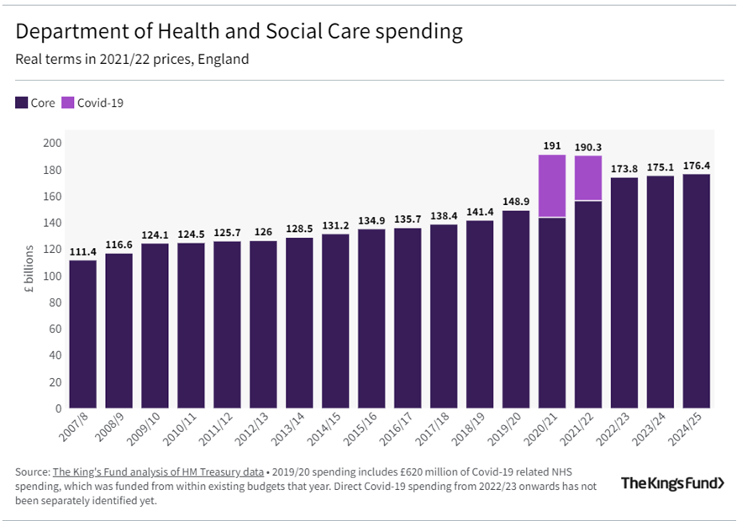
Description of Scale (Cont)
England planned to cut of the funding to healthcare, in fact, funded an additional £33.8 billion to combat the Covid-19 pandemic.
Notes:
II. In the UK, more than one person with diabetes symptoms—diagnosed or undiagnosed—was present for every According to the research, funding could be reduced by almost 30 billion euros between 2013–2014 and 2020–2021. The existence of Covid-19, however, altered their plan of action. The Department of Health and Social Care's assessment estimates that England needed to provide an additional £33.8 billion to combat the Covid-19 pandemic. An illustration is below.

Slide 6
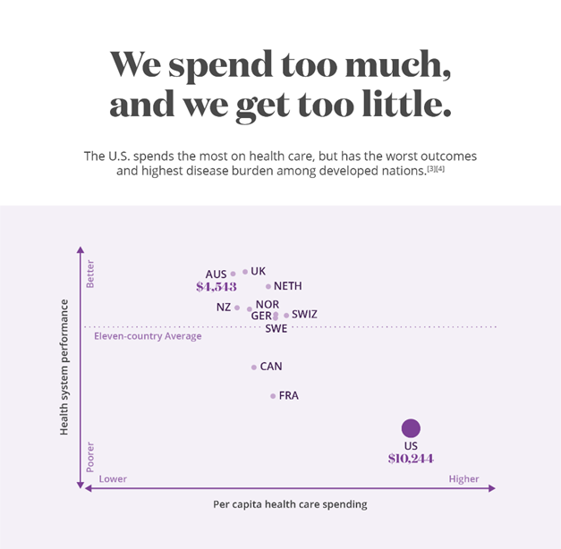
Description of Scale (Cont)
The dreary picture applied to the US healthcare
Paid highest but gain least in developed countries
⇒ US is researching on Value-based commision
http://dolanecon.blogspot.com/2018/01/why-we-spend-so-much-on-healthcare-and.html
Notes:
The case study was a dreary about the UK healthcare industry but also a potential future for developed countries, including the US. Plus, with the onset of Covid-19, all countries in the world are affected by the pandemic, with the loss of human and financial issues. During this time, the National Health Expenditure reported that all aspects of healthcare grew from 3.5% to 9.5% in 2020. Moreover, the US spent the highest spending on healthcare, but we gain the least quality in developed countries. To reduce medical expenses while still providing patients with the best value, the US is therefore also paying attention to this value-based issue.

Slide 7
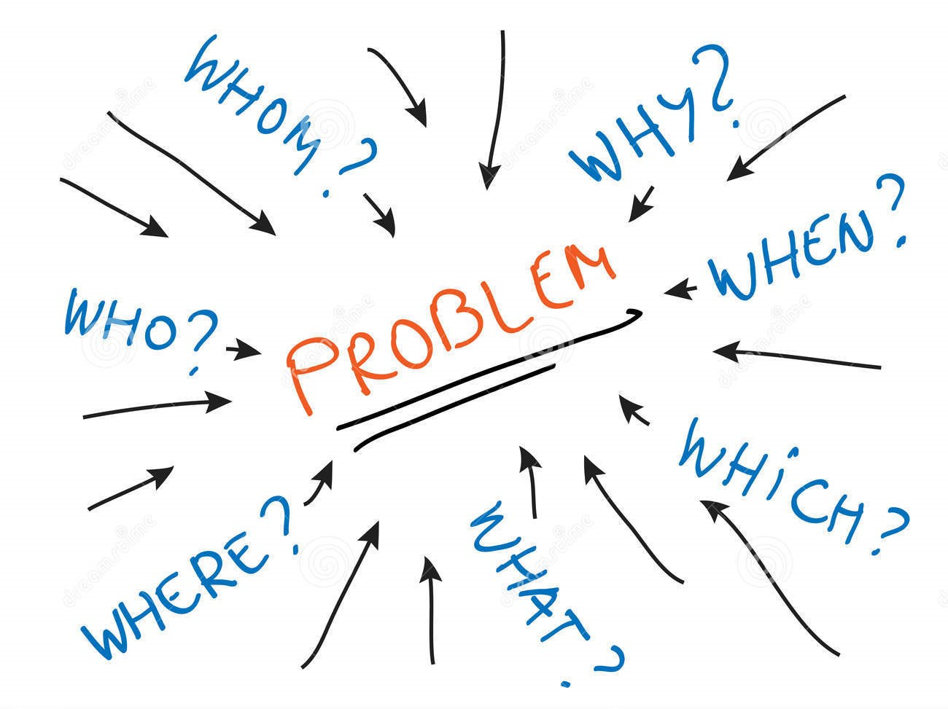
Description of
Problem
England government is looking for a change in the existing healthcare and payments system
Looking to implement a value-based and outcome-based approach to healthcare
Value Based Care Issues:
Resistance of users
Risk to organizations
Clinical risks for providers
Hesitancy to change for various departments
Notes:
England government is looking for a change in the existing healthcare and payments system. An improvement in costs and care. Main agenda of the case is to implement a value-based and outcome-based approach to healthcare planning and purchasing. We’re trying to achieve a measurable improvement in patient benefit along with a reduction in cost for services in healthcare. Alignment of payments and quality care towards patients is being considered and made trials for.

Slide 8

Description of Problem
Final agenda would be to arrive how we could reorganize health care delivery through value-based approaches such that the NHS commission in England and the patients or the population that is being targeted would benefit.
New system that is to be implemented must lead to better patient outcomes and coordinate well with the incentives.
Notes:
There are three phases in the project being implemented out of which the final phase was incomplete. First two phases are to define population their outcomes and designing IPU and evaluating models. Third phase was difficult as it the implementation part.
English health care system exceed their budget and we would like to change the costs via different payment models.
In conclusion, we would like to know if the Value Based Commission project would be implemented.

Slide 9
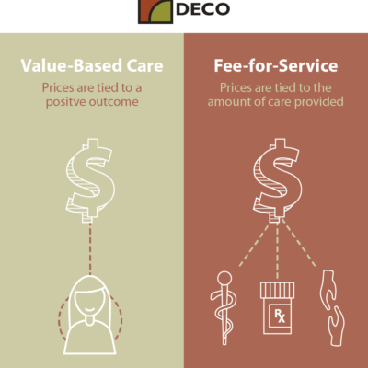
Value Based Care
Why these outcomes and measuring them all matter for high quality in healthcare—hence the value?
The only true measures of quality: the outcomes that matter to patients.
Outcomes are a strong tool to increase transparency and doctors' satisfaction, not simply that of patients (and owners).
Cost reduction and value enhancement are both strongly influenced by outcome improvement.
Notes:
We are working toward to new era of healthcare system is value-based care. The only true measures of quality are the outcomes that matter to patients. Outcomes are the result of care in terms of the patient's health over time. Results are further improved when they are measured and reported because this encourages improvement and the adoption of best practices which creates the outcomes brought to patients with a particular clinical condition over the full cycle of care, which normally involves multiple specialties and care sites.
Outcomes are a strong tool to increase transparency and doctors' satisfaction, not simply that of patients (and owners). For long-term learning and service improvement, measuring and reporting outcomes is essential. The care team can improve and consequently have a beneficial impact on outcomes by comparing their performance to that of peers both inside and outside of their organization. Furthermore, cost reduction and value enhancement are both strongly influenced by outcome improvement.

Slide 10
Value Based Care
What are some possible conflicts in different stakeholder perspectives in regard to implementing value-based medicine?
STAKEHOLDERS
Employers
Health Facilities
Practitioners, etc
Consumers/Patients
Providers’ perspectives: cost-saving program (value-based care) are untrustworthy. The reasons stated that the plan makers were more focusing on cutting costs than needed services that were asked for patients.
Patients’ perspective/consumers: The most worrying from patients is not the quality of services even their doctors are not as high quality but the cost.
Notes:
Some stakeholders in the country’s healthcare system include consumers, employers, health facilities, practitioners, etc.
According to National Library of Medicine, from providers, they think that these cost-saving program (value-based care) are untrustworthy. The reasons stated that the plan makers were more focusing on cutting costs than needed services that were asked for patients.
From patients, or sometimes we can understand as consumers. A slight difference between “patients” and “consumers” is patient actively undergoing a course of treatment for a particular illness may differ significantly from the perspective of a healthcare consumer who may acquire goods and services over the course of a lifetime but not be actively in treatment. The most worrying from patients is not the quality of services even their doctors are not as high quality. Patients frequently worry that the concept of "evidence-based" medicine may limit the treatment options available to their doctors and suspect that there may be a covert motive of cost cutting behind it.

Slide 11
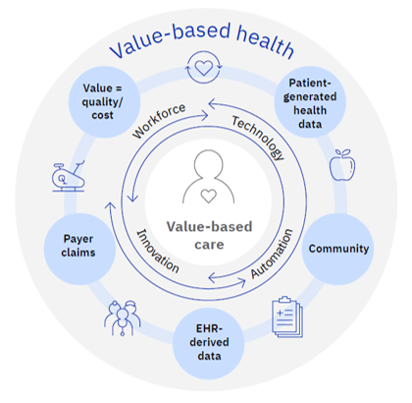
Goals of the problem
Design a process to focus on improvement of the current system and health.
Provide outcomes that align with the perspective of healthcare providers, quality care and cost efficient.
Ensure teams internally or externally are providing quality care.
Find the costs related to every patient and service provided along with the efficiency/outcome and to validate if the prices/payments would cover or are worth covering the treatment plan.
Create an integrated approach or pathway which improves care and cuts most of the spending.
Notes:
We would like to concentrating on producing a design to focus on improvements of current system. To align outcomes accordingly to provide quality care by healthcare providers and their internal or external teams. We expect to find the related costs towards a patient and implementation of the plan with an integrated approach to cut a good amount of spending costs.

Slide 12
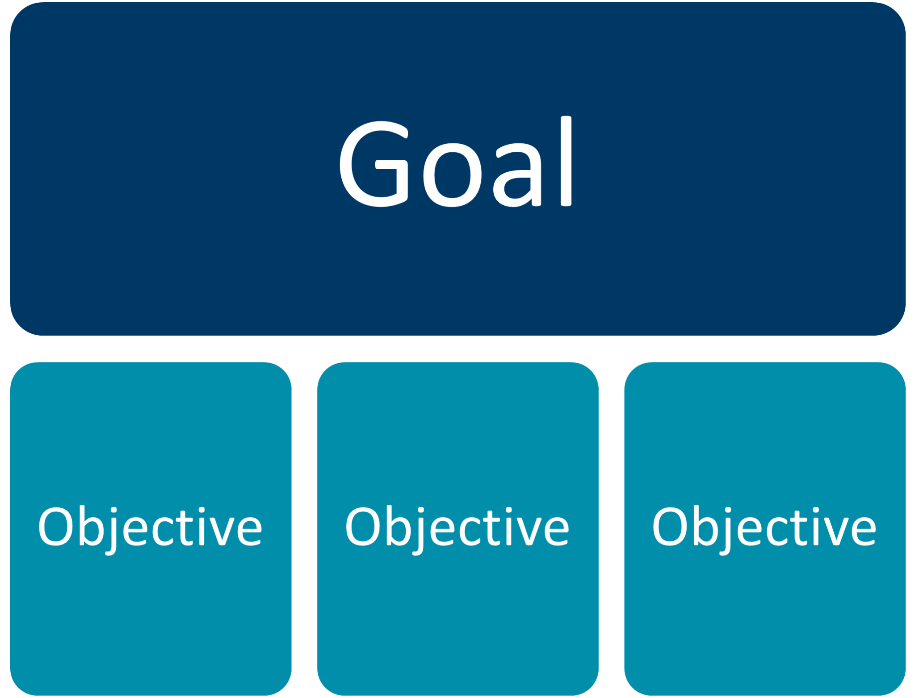
Goals of the problem
To know what kind of commissioning works for an organization or clinical practitioner
Form a value-based care operational model that must be used by clinicians, health care organizations
Bundling different care providers to treat diabetes ensuring patient-centered care outcomes
Comply with the policies and guidelines enforced by the government
Forming an agreement or contract model
Notes:
Every organization works differently within themselves and externally, our approach would be to find an operational model among different payment models and providers. To ensure that all the policies, guidelines and agreements are friendly towards user, provider and government.

Slide 13
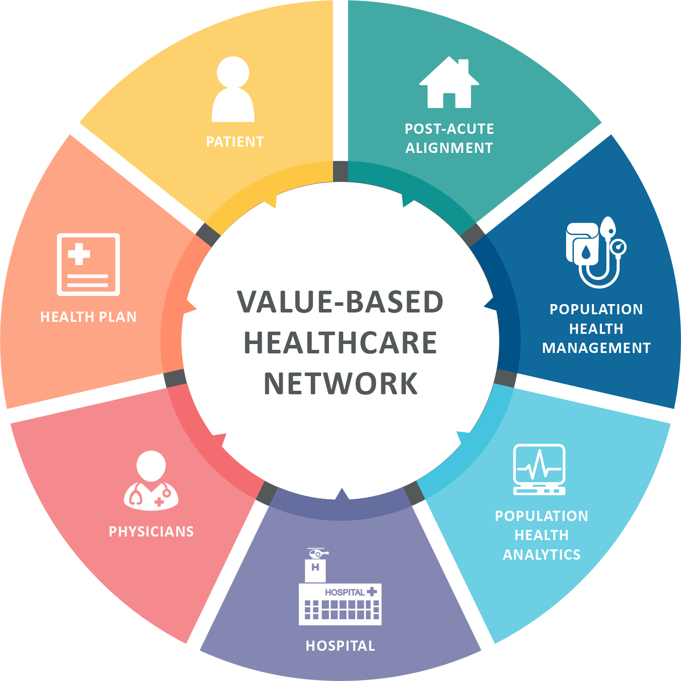
Health Care Informatics Relevancy
The applications of healthcare analytics contribute to solutions in the following ways:
By using data to identify areas for improvement, create strategies for cost cutting, and improve patient safety.
By providing insights into the effectiveness of care delivery. and identify areas to improve patient outcomes by analyzing patient data.
Pinpointing areas with a higher likelihood of unfavorable events or outcomes, healthcare professionals can manage patient care and reduce the possibility of unfavorable outcomes.
Identifying patient population patterns and places where changes can improve population health by analyzing patient data.
Notes:
Healthcare analytics is a new discipline in the healthcare sector that analyzes data to produce insights that could be used to improve patient outcomes. Below is the explanation for the same:
By enabling the discovery of patterns and trends in patient data and the identification of potential improvement areas, the use of healthcare analytics can improve patient care.Care delivery gaps, hotspots, and potential improvement zones can all be found using healthcare analytics.
It can also be used to identify potential areas for care delivery improvement, such as pinpointing care areas that need to be addressed to lower readmission rates or raise patient satisfaction.
Healthcare analytics may also be used to identify risky areas in patient care.
Analyzing patient data which will help to understand patient groups and develop care plans that are tailored to their unique needs.
By identifying high-risk locations, ineffective uses of resources, and potential areas for treatment delivery improvement, healthcare analytics can help healthcare professionals maximize patient outcomes. Healthcare providers can better understand patient demographics and tailor treatment plans to suit their needs by using healthcare analytics to identify opportunities for population health improvement.
Finally, population health improvement potential may also be found using healthcare analytics.

Slide 14
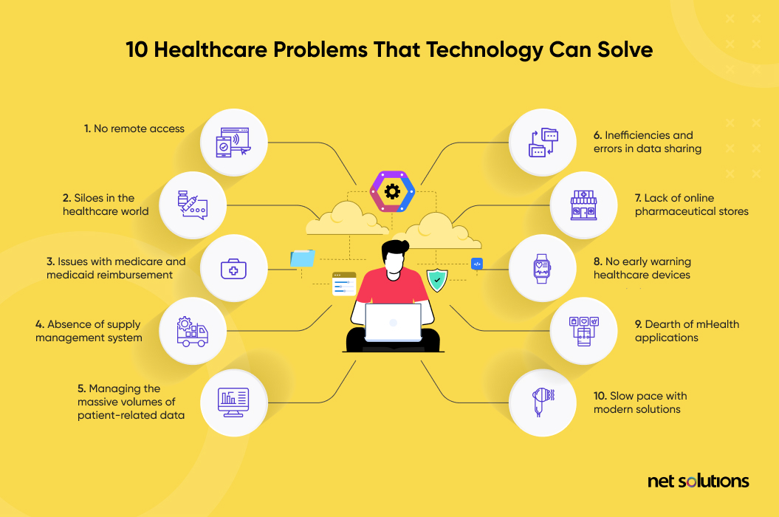
Health Care Informatics Relevancy
It is true that using analytics or health information technology improperly can lead to issues. Some of them are:
Healthcare practitioners might not be able to access, evaluate, and act on patient data.
Lead to incomplete or erroneous information due to incorrect data collection and processing.
Higher costs and worse patient outcomes.
Inaccuracies in data collection and analysis.
Missed opportunities to improve patient outcomes.
Notes:
Additionally, the issues can also be due to Healthcare workers' ability to track and monitor patient outcomes may be hampered by improper use of analytics or health information technology. Healthcare personnel could miss opportunities to identify areas where care delivery might be improved in the absence of reliable and timely data.
Finally, ineffective care delivery may be caused using analytics and health information technology. Healthcare practitioners might not be able to spot areas of unnecessary utilization and chances for improvement without precise and timely data
Hence, To improve patient outcomes, it is vital for healthcare workers to make sure they are using analytics and health information technology appropriately.

Slide 15
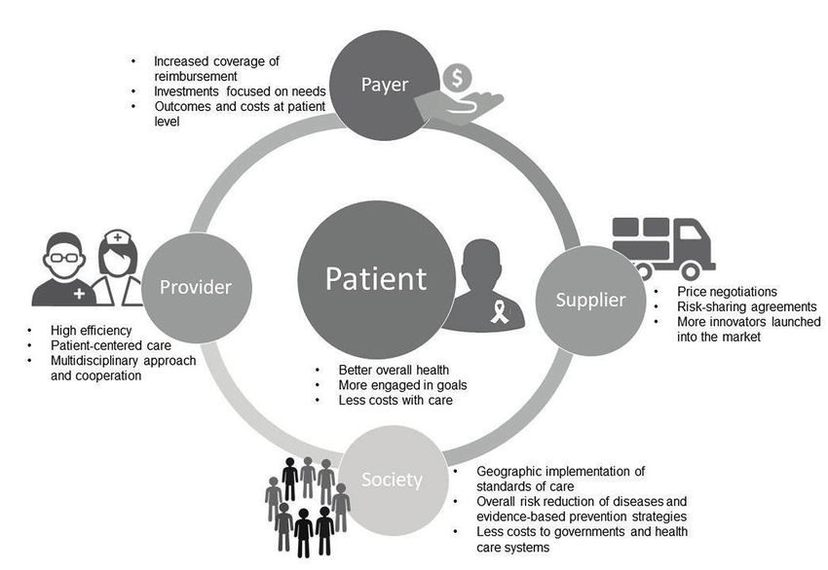
Health Care Informatics Relevancy
Ways to improve the challenges:
Adopting processes and practices that ensure data is gathered and processed quickly.
Make sure they have the equipment and procedures required to appropriately evaluate patient data.
Have a thorough system in place for gathering, analyzing, and acting on patient data.
Have the staff and resources needed to retain patient data and carry out procedures to improve patient outcomes
Notes:
There are several approaches to enhance the use of analytics or health information technology to solve the problems outlined in the case. Healthcare practitioners should ensure that they have access to accurate and timely data, the necessary tools, and systems for evaluating patient data, and a rigorous process for collecting, analyzing, and acting on patient data. By utilizing analytics and health information technology effectively, healthcare professionals may improve patient outcomes.

Slide 16
Effects
Positive
Negative
Great improvement for quality
More patient feedback
Decreases costs because there may not be as many tests being performed
Focuses more on proactive care to manage chronic illness
Patient engagement increases between patients and providers
Could dismantle organization operations
Need sufficient data analytics to perform VBC efficiently
Can lead to decrease in incentives for providers and healthcare entities
inefficient operations due to high volume
Provides greater risk for providers
Financial risk for providers
Notes:
Moving Towards Value Based Care Positive Effects
Great improvement in terms of quality for patients b/c physician is focused on outcome more than anything else
VBC provides more patient feedback which is helpful for physicians to adjust their practices
Decrease costs because there may not be as many tests being performed to provider the outcome
Focuses more on proactive care to manage chronic illness again benefiting patients
Patient engagement increases between patients and providers
Moving Towards Value Based Care Negative Effects
Could dismantle organizational and operational components of healthcare that are already working well
Without sufficient data analytics skills value based care can not be performed efficiently and can lead to a decrease in incentives for providers and healthcare entities
Increase in patient load making organization and operation of provider care and healthcare entities less efficient
Provides greater risk for providers as they play a larger part in outcomes and quality care
Could be a financial risk for providers if there are working with integrated systems and other providers are not providing the same quality

Slide 17
Goals Assessment
Goals | Aim of the goal | Current Status | GOAL MET OR NOT
Focus on improvement of the current system and health | Incompatible with transforming changes towards reorganizing health care services | Will not sustain as we would need a new design | No
Provide outcomes that align with the perspective of healthcare providers, quality care and cost efficient | An important goal towards achieving value-based healthcare as It ensures that quality care is delivered to a patient while it is cost efficient to the provider | Based on results rather than the quantity of treatments performed, the number of patients seen, or the amount of money billed, so that hospitals and doctors are compensated appropriately | Yes
Ensure teams internally or externally are providing quality care | Basic component towards achieving our result and it does not need to be viewed as a goal | Reducing hospital readmissions, using certified health IT, improving preventative care and value-based care programs resulted in providing quality care internally and externally | Yes
Notes:
We find improvement of the current system in place no longer sustaining and it does not meet. We are able to align our outcomes and ensure teams to be providing quality care with the goal being met.

Slide 18
Goals Assessment
Goals | Aim of the goal | Current Status | GOAL MET OR NOT
Find the costs towards each patient and service with its price efficiency | Would play a significant role in helping the government in annual budgeting for healthcare as this would estimate the costs related to the patient services and also useful to the clinicians in advanced analytics and process improvement | Would play a significant role in helping the government in annual budgeting for healthcare as this would estimate the costs related to the patient services. useful to the clinicians in advanced analytics and process improvement | Yes
Provide outcomes that align with the perspective of healthcare providers, quality care and cost efficient | An important goal towards achieving value-based healthcare as It ensures that quality care is delivered to a patient while it is cost efficient to the provider | Based on results rather than the quantity of treatments performed, the number of patients seen, or the amount of money billed, so that hospitals and doctors are compensated appropriately | Yes
Create an integrated approach or pathway which improves care and cuts most of the spending | Observe that all the parties involved are not affected financially or at financial risk by cutting costs/spending | Ultimately result in cheaper healthcare expenditures in the long run by prioritizing preventative actions | Yes
Notes:
Our research found out that costs play a significant role and the related costs were decreased. In exhibit 4, we find a significant decrease in costs through the new purchasing model and the reimbursement model by England. Our outcomes were aligned with our goals and have an integrated approach towards value care.

Slide 19
Goals Assessment
Goals | Aim of the goal | Current Status | GOAL MET OR NOT
To know what kind of commissioning works for an organization or clinical practitioner | Commissioning and delivering integrated care in a structured model is to ensure effective delivery of services, clear roles and responsibilities and a system of care to support self-management and effective outcomes | Reviews the payments system to the provider. Our goal is to achieve the best commissioning model and to see if it is preferred by the provider. | Yes
Comply with the policies and guidelines enforced by the government | Have systems in place to distribute policy documents to staff and organizations under their control and to monitor compliance | Check if all the requirements are met and necessary changes have to be made in the future if it does not match or agree with a policy | Yes
Forming an agreement or contract model | Crucial role in overcoming challenges, such as alignment of stakeholder incentives, insufficient data infrastructure, and regulatory concerns | By creating a contract like VBA, payers will be less financially risky when introducing new innovations, overcoming a weak data infrastructure . Regulatory issue related to data sharing, infrastructure. | Yes
Notes:
New model works with the organizations and also complies with all the policies, guidelines and agreements.

Slide 20
Case Study Recommendations
We would recommend the Governing Body endorse this Business Case, in particular the following:
Patients in this cohort should be able to access IPU services throughout Haringey and Islington, as well as continued collaboration between Haringey and Islington CCGs.
To move on with the tasks necessary to advance Value Based Commissioning for patients with diabetes in Haringey and Islington in accordance. This will involve establishing new contractual obligations to help VBC.
The Governing Body will be requested to give its approval when a provider is chosen to play a leadership role in this work.

Slide 21

Recommendations to Improve the Value Based Healthcare System
Adopt a common terminology so that every person involved in healthcare has a shared understanding of what value-based healthcare is
Recognize and develop strategies to overcome barriers to implementing value-based healthcare at the individual, team and organisational level.
Translate and implement the best available research evidence into effective action to increase value

Slide 22

Recommendations to Improve the Value Based Healthcare System
Training staff in how to measure outcomes, patient experience and resource use
Ensure programs to increase value are monitored and evaluated to provide better evidence about what is and isn’t effective
Facilitate better communication and dissemination about what works in increasing value at a local and national level

Slide 23
Recommendations to Improve Other Chronic Diseases
Original case study catered to the diabetics
Few aspects missing from diabetes plan
Did not implement healthcare technology and systems to view data on how to improve quality
Did not give providers and caregivers time to adapt to changes
Recommendation plan improves the diabetes plan and allows it to be implemented for many chronic diseases
Important for VBC to be used in acute illness because
VBC provides quality to these patients who constantly need healthcare
VBC creates precedents so providers have a set plan of how to treat these illness and
Providers physicians with framework to adapt to increase quality in the future
Can focus more on prevention of an acute disease by using data analytics from previous cases that have gone through care in a VBC system

Slide 24
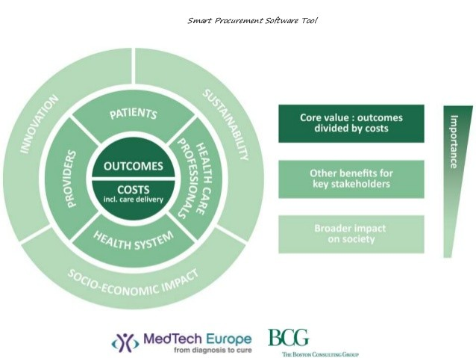
Recommendations
RECOMMENDATIONS FOR CLINICAL COMMISSIONING GROUPS(CCGs):
Recognition of the need for integrated care for people with long term conditions
Recognize the scale of the problem for diabetes, complexities and those at risk
Foster and support good leadership
Re-think funding systems so that true collaboration and integration can take place
Work with health and wellbeing boards
Design systems with end-users in mind
Identify key outcomes that capture the essence of integrated care
Enhancing capacity and competency in primary and community care
Highlight new research findings and support transition to clinical care
Notes:
Recognition of need for integrated care for people with long term conditions, recognizing scale of the problem are the key recommendations as they would help to provide better outcomes in value based healthcare. This would also help to overcome the risks in the value based healthcare systems.

Slide 25
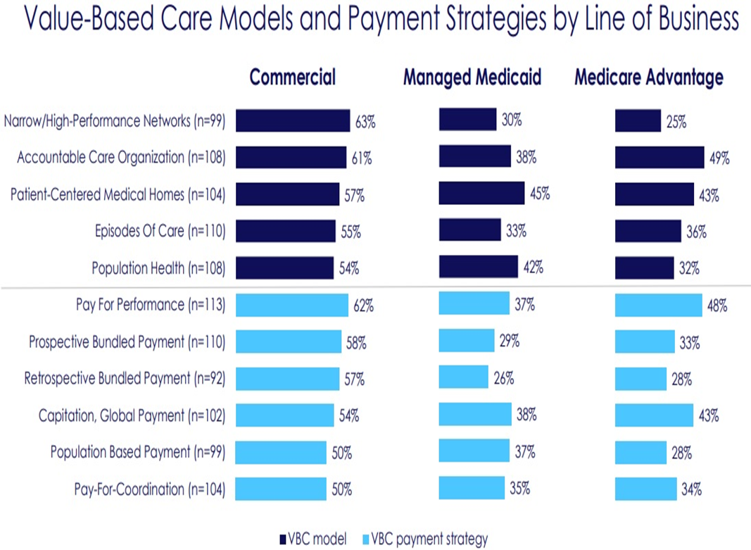
Recommendations
VBC PRICE ESTIMATE:
Value based care reduces costs by 5.6% improving quality of care
Notes:
The graph clearly shows how value based care reduces the costs by improving quality of care through various payment strategies.

Slide 26

Our Recommendations
RISK ASSESSMENT
Lack of resources
Technology interoperability challenges
Financial risk and unpredictable revenue streams
Shifting policies and regulations
Difficulty collecting and reporting patient information
Notes:
Lack of resources would lead to many challenges in reorganizing the value-based healthcare system. We need to assess financial risks and changes in policies. It would be difficult to collect information with the current model.

Slide 27
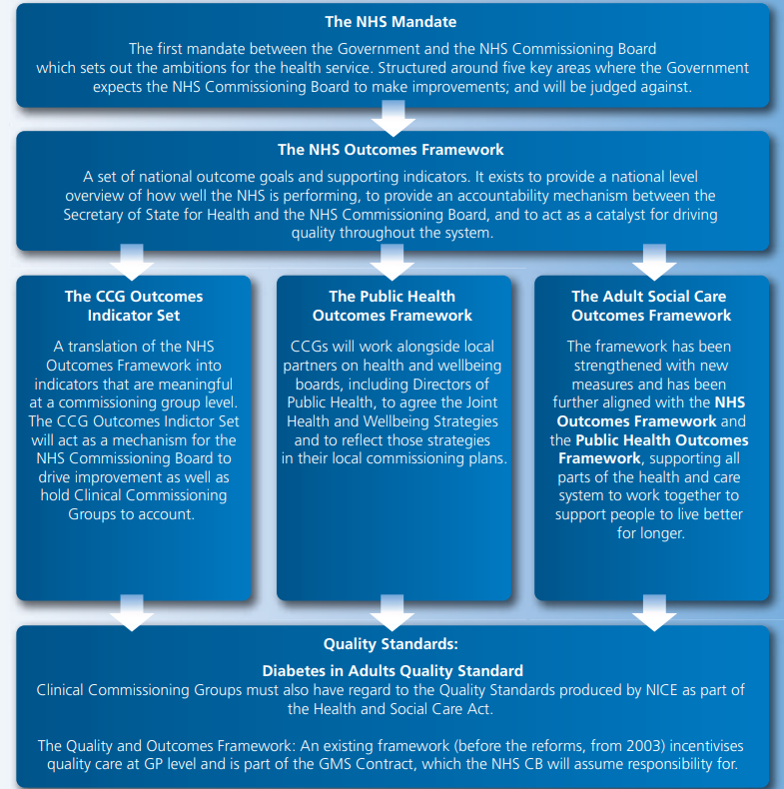
WHAT CCGs MUST DO :COMMISSIONING FOR OUTCOMES

Slide 28

COSTS
Diabetes cost approximately £ 23.7bn in the UK in 2010/2011: £ 9.8bn in direct costs (£1bn for Type 1 diabetes and £ 8.8bn for Type 2 diabetes) and £ 13.9bn in indirect costs (£ 0.9bn and £ 13bn).
In real terms, the 2035/2036 cost is estimated at £ 39.8bn: £ 16.9bn in direct costs (£ 1.8bn for Type 1 diabetes and £ 15.1bn for Type 2 diabetes) and £ 22.9bn in indirect costs (£ 2.4bn and £ 20.5bn).
Sensitivity analysis applied to the direct costs produced a range of costs: between £ 7.9bn and £ 11.7bn in 2010/2011 and between £ 13.8bn and £20bn in 2035/2036.
Diabetes currently accounts for approximately 10% of the total health resource expenditure and is projected to account for around 17% in 2035/2036.
Notes:
Our study found that if the current health system continues the current complications will grow.
Costs reference : https://pubmed.ncbi.nlm.nih.gov/22537247/

Slide 29
Q1: Why implement value-based care? Is there a need to monitor outcomes across the integrated practice unit (IPU) and modify provider contracts?
Why Implement Value Based Care (VBC)
healthcare previously based on the inputs and money spent on achieving health outcomes
implementing VBC provides patients with emphasis on the quality of care and shifts how patient care is administered
cuts costs because looking at improved outcomes rather than inputs may decrease the amount of unnecessary testing, lab work or incorrect diagnosis
Need to monitor IPUs because:
provides collaborative discussion amongst an array of healthcare professionals
helps increase the quality since there is integrated care
provides direct data showing the correlation of having integrated care on the quality of care versus not having these IPU’s
Based on this statistical data, the system can further go and modify provider contracts depending on how well they are collaborating and what their patient outcomes are.
Notes:
Value based care was previously based on the relative on the inputs and money spent on achieving health outcomes but not the value and quality of the care provided to achieve outcomes.Implementing value based care provides patients with an emphasis on the quality of care provided to them and shifts how patient care is administered. This will overall improve the healthcare space for patients and providers. It can also cut costs as looking at improved outcomes rather than inputs may decrease the amount of unnecessary testing, lab work or incorrect diagnosis.
There is a need to monitor outcomes across an IPU as the IPU (Integrated Practice Unit) provides collaborative discussion amongst an array of healthcare professionals and helps increase the quality since there is integrated care. By monitoring the outcomes of the IPU’s, there can be direct data showing the correlation of having integrated care on the quality of care versus not having these IPU’s. Based on this statistical data, the system can further go and modify provider contracts depending on how well they are collaborating and what their patient outcomes are.

Slide 30
Q2: Value-based commissioning is a very new proposition in the health system. How is it different from earlier initiatives in the areas of patient safety, quality management, or patient flow optimization?
VBC is very different from earlier initiatives
previous years mainly focused on fee for service
Fee for service = correlating patient care to how many procedures were done and the cost of those procedures in order to solve the problem
VBC focuses on the way that this journey happens and what steps can be taken in order to improve the quality of care given
A few aspects that they differ in:
Increase in terms of quality with VBC
Increase in safety because physicians are more careful of the outcomes for patients
Financial incentive for physicians if there is increase in safety and accuracy
Possible decrease in patient flow optimization because VBC leads to of increase in patient volume
operations can get quite confusing with a greater volume
Notes:
Value based commissioning is very different from the earlier initiatives as the previous years mainly focused on fee for service. Fee for service focused on correlating patient care to how many procedures were done and the cost of those procedures in order to solve the problem. However, value based commissioning focuses on the way that this journey happens and what steps can be taken in order to improve the quality of care given. There are a few aspects that they differ in. There is an obvious increase in terms of quality with VBC as discussed throughout this presentation; however there is also an increase in safety and patient flow optimization. In terms of safety there is an increase for patients as the physician focuses on value meaning they are more careful of the outcomes for patients. These outcomes directly relate to their reimbursement giving them a social and financial incentive to increase their accuracy. For patient flow optimization, VBC can have an adverse effect because although there is an increase in quality it can often come with an increase in patient volume. This increase in volume can decrease patient flow as operations can get quite confusing with a greater volume.

Slide 31
Q3: If you were a physician, how comfortable would you be signing a contract where a portion of your income is tied to the performance of other physicians in the value chain?
Something that physicians can struggle with because it is a very different method in comparison to past income forms
Having their revenue tied to other physicians can cause many issues amongst physicians and disrupt the integration workflow
If we were to be physicians, we would feel conflicted by signing this contract as it creates a great amount of risk within our profession
an uncomfortable feeling to know that another physician's mistakes or lack of care in terms of quality can affect my income
However, VBC provides a framework for providing the best possible care for the patient and focusing on their quality of care. As a physician we would be able to sign the contract knowing that in the future it will have higher reward with quality and financial revenue.
Notes:
This is something that physicians can struggle with because it is a very different method in comparison to their past income forms. Having their revenue tied to other physicians can cause many issues amongst physicians and disrupt the integration workflow. If we were to be physicians we would feel conflicted by signing this contract as it creates a great amount of risk within our profession. It would most definitely be an uncomfortable feeling to know that another physician's mistakes or lack of care in terms of quality can affect my income. However, it is important to note that VBC provides a framework for providing the best possible care for the patient and focusing on their quality of care. With this in mind, as a physician we would be able to sign the contract knowing that in the future it will have higher reward with quality and financial revenue.

